Slide 1
22/02/2022
Title: Test review
Aim:
Be able to use ‘same sides add – different signs subtract’ with all operations.
Plan:
Daily review:
Decimal division.
Irrational numbers.
Addition / subtraction
Test revision.
Cheat sheets.

Slide 2

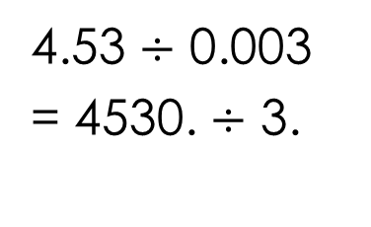
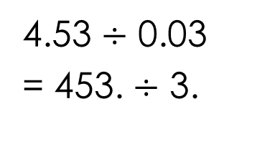
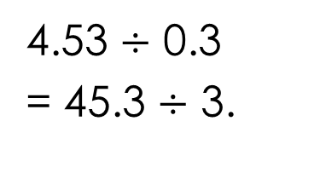
Division by a decimal.
That is, this number cannot be a decimal.
eg: 4.53 $÷$ 0.3
Rule #1: You can’t divide by a decimal.
Method: increase the value of the decimal by multiplying by 10, 100, 1000, etc
BUT
If you multiply one of the numbers by 10, 100, 1000 then you must multiply the other number by 10, 100, 1000.
4.53 $÷$ 0.3
= 45.3 $÷$ 3.
4.53 $÷$ 0.03
= 453. $÷$ 3.
4.53 $÷$ 0.003
= 4530. $÷$ 3.
Standard algorithm: $∗∗$ line up the decimal points $∗∗$
Notes:
Show process manually

Slide 3
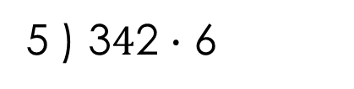

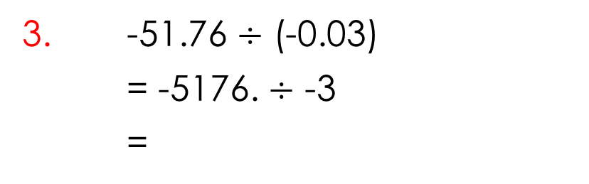
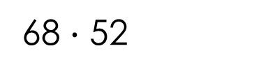
Whiteboards
68 $∙$ 52
1. 34.26 $÷$ 0.5
= 342.6 $÷$ 5
= 68.52
2. -13.76 $÷$ 0.004
= -13760. $÷$ 4
=
5 ) 3$4$2 $∙$ 6
3. -51.76 $÷$ (-0.03)
= -5176. $÷$ -3
=

Slide 4

Pair share
Explain why $\sqrt{5}$ is an irrational number.
If we try to convert $\sqrt{5}$ to a decimal, the decimal does not terminate or recur. This makes it irrational.

Slide 5
Daily review – addition / subtraction
Same signs add different signs subtract.
To deal with the double sign
4 – (-3)
= 4 + 3
-4 + (-3)
= -4 – 3
Can also be used for addition and subtraction
-2 – 5
= -7
Same signs add (but negative answer)
-2 + 5
= 3
Different signs subtract (highest number positive so positive answer

Slide 6
Examples into our notes page
-23.456 + (-5.68)
= -23.456 – 5.68
= - 29.136
Double signs first
Same signs add (but negative answer)
23 . 456
+ 5 . 680
2 9 . 136
-59.28 - (-84.93)
= -59.28 + 84.93
= 25.65
Double signs first
Different signs subtract (highest number positive so positive answer
84 . 93
– 59 . 28
25 . 65
-59.28 - (-34.93)
= -59.28 + 34.93
= - 24.35
Double signs first
Different signs subtract (highest number negative so negative answer.
59 . 28
– 34 . 93
24 . 35

Slide 7
Test revision

